Slide 1
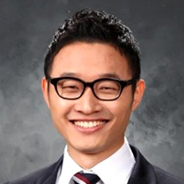
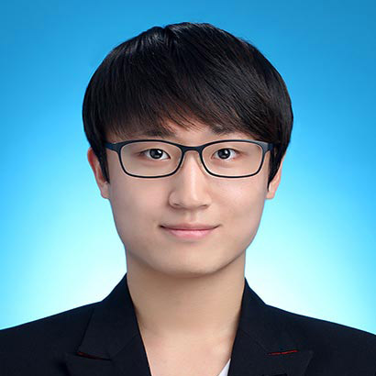

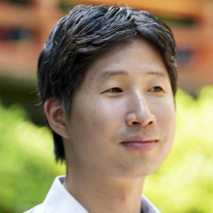

Better to Follow, Follow to Be Better: Towards Precise Supervision of Feature Super-Resolution for Small Object Detection
Junhyug Noh
Soochan Lee
Beomsu Kim
Gunhee Kim

Slide 2
Contents
Backgrounds
Object detection
Object detection models
Pedestrian detection and its issues
Our solutions
Occlusion handling method
Hard negative handling method
Experiments

Slide 3
Backgrounds

Slide 4
Object Detection
https://github.com/tensorflow/models/tree/master/research/object_detection
Notes:
This image is the result of object detection.
If the image is given, objects are detected like this.
For example, this, the model predicts that the person is here with 99% confidence.

Slide 5
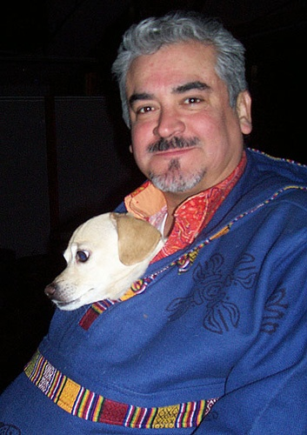
Object Detection
To enable the model to make these predictions, we need an image dataset with annotations about
Location
Where is the object?
Class
What is the object?
person
dog
Notes:
이를 위해서는 학습을 위한 데이터셋이 필요하겠죠.
당연히 이미지들이 필요할 것이고, 각 이미지에 대한 annotation이 주어져야 합니다.
Annotation은 location과 class에 대한 정보입니다.

Slide 6
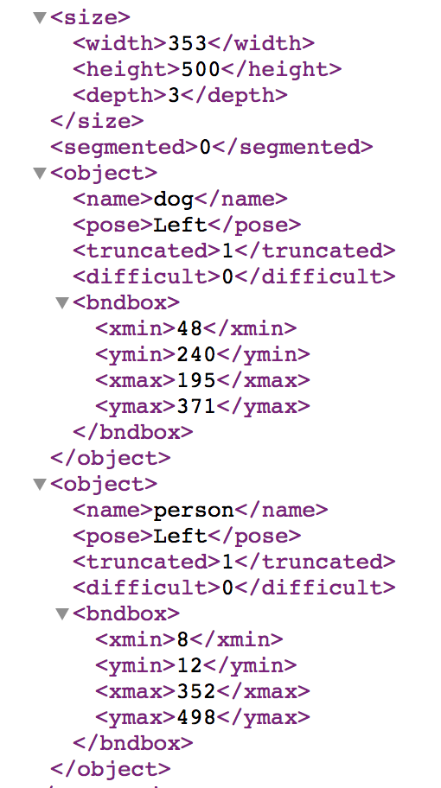
Object Detection
person
dog
Notes:
So here’s the real annotation of this image.
If this kind of annotation is given, we can make the model to detect the objects.

Slide 7
Object Detection Datasets
PASCAL VOC
http://host.robots.ox.ac.uk/pascal/VOC/
20 object classes
COCO
http://mscoco.org/
80 object classes
Open Images
https://storage.googleapis.com/openimages/web/index.html
600 object classes
Notes:
These two datasets are most frequently used dataset for object detection.
Normally, papers for general object detection report the performance on these datasets.
Voc: 20K images
Coco: 330K images
Open: 1.74M images

Slide 8
Object Detection Models
Two most influential research streams
Two-stage model
Proposal-based model
Consists of a region proposal module and a recognition module
Single-stage model
Proposal-free model
Removes the proposal module and predicts object positions and classes directly
Notes:
two-stage는 정확
single-stage는 빠름

Slide 9
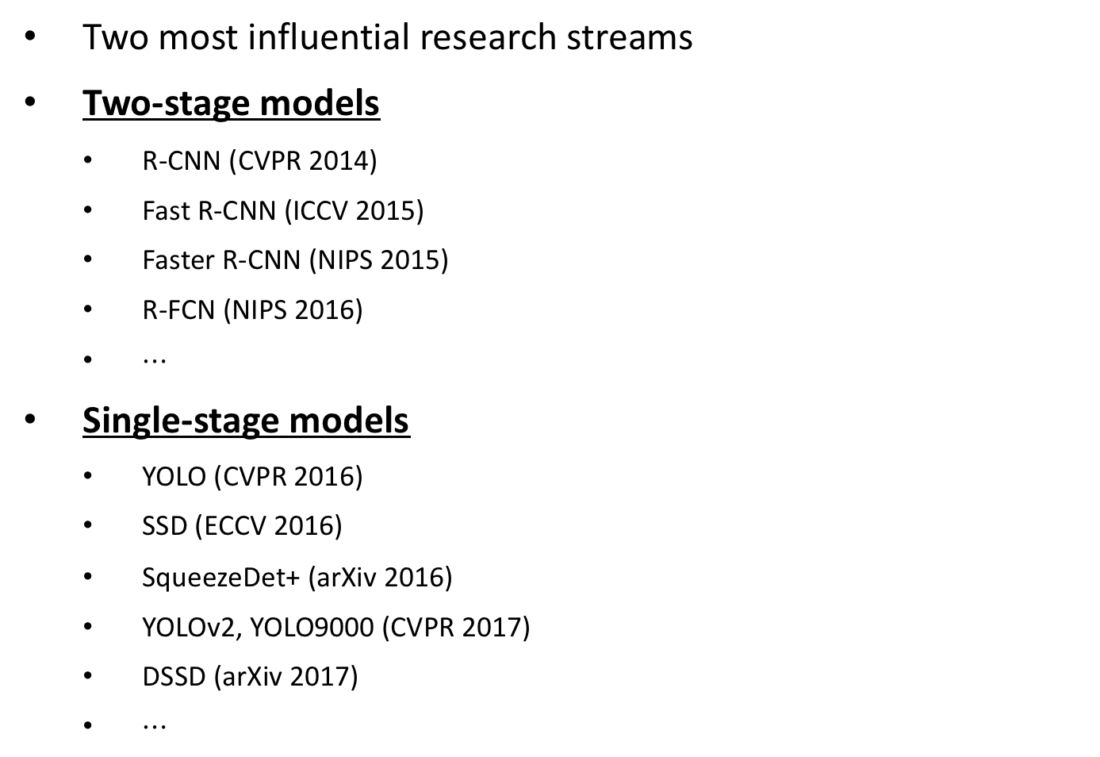
Object Detection Models
Two most influential research streams
Two-stage models
R-CNN (CVPR 2014)
Fast R-CNN (ICCV 2015)
Faster R-CNN (NIPS 2015)
R-FCN (NIPS 2016)
$⋯$
Single-stage models
YOLO (CVPR 2016)
SSD (ECCV 2016)
SqueezeDet+ (arXiv 2016)
YOLOv2, YOLO9000 (CVPR 2017)
DSSD (arXiv 2017)
$⋯$

Slide 10
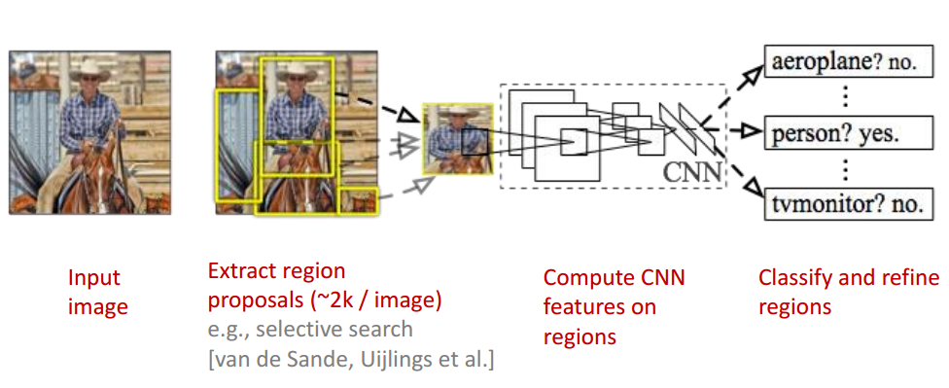
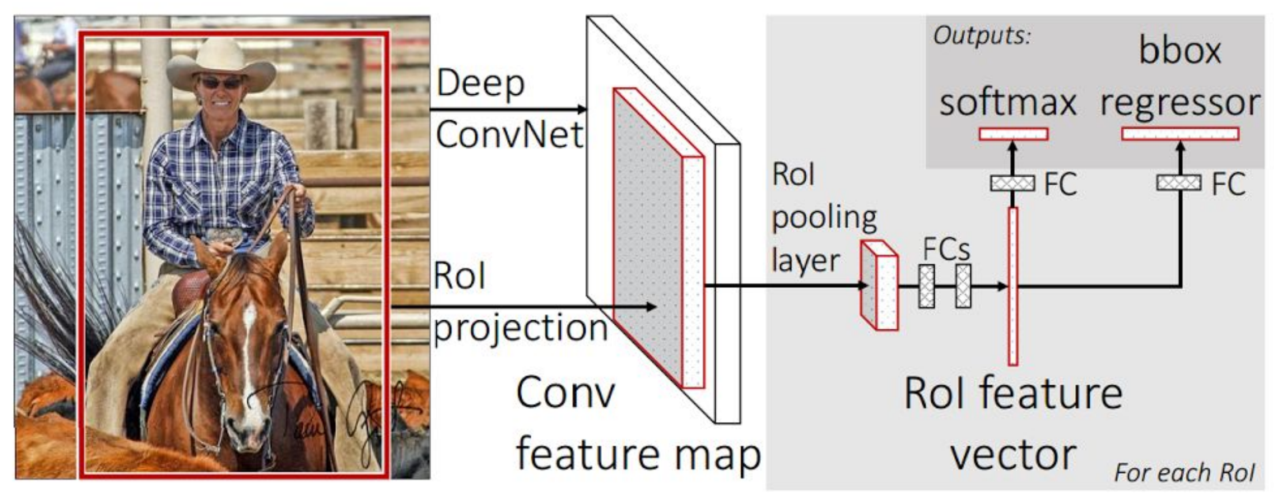
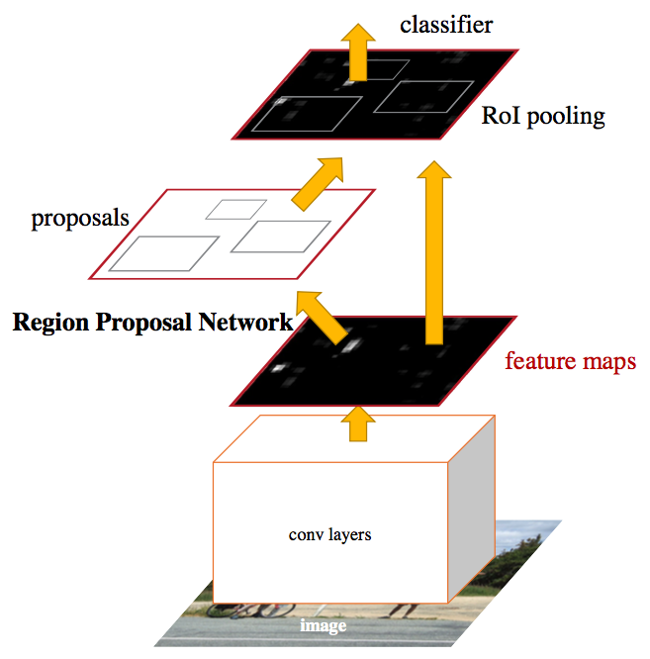
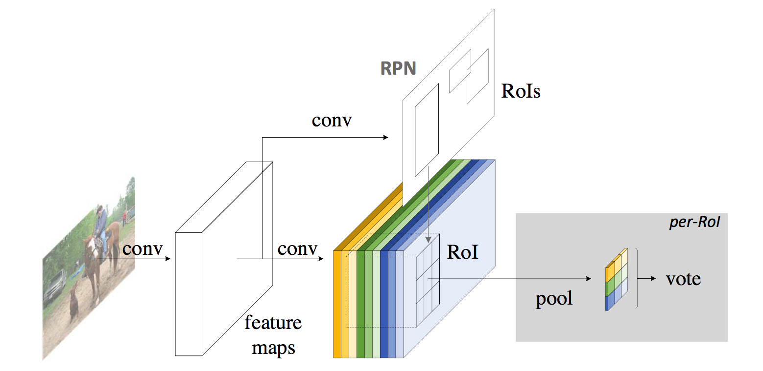
Object Detection Models
Two-stage models
R-CNN (CVPR 2014)
Fast R-CNN (ICCV 2015)
R-FCN (NIPS 2016)
Faster R-CNN (NIPS 2015)

Slide 11
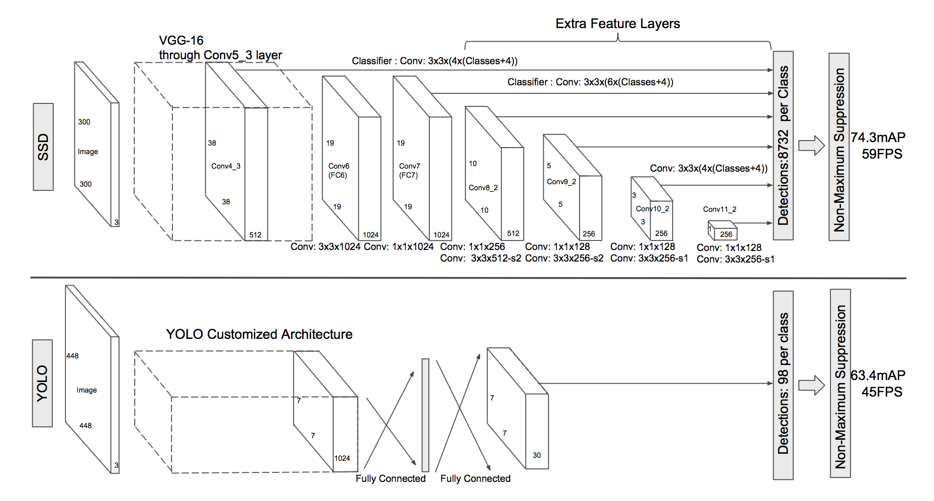
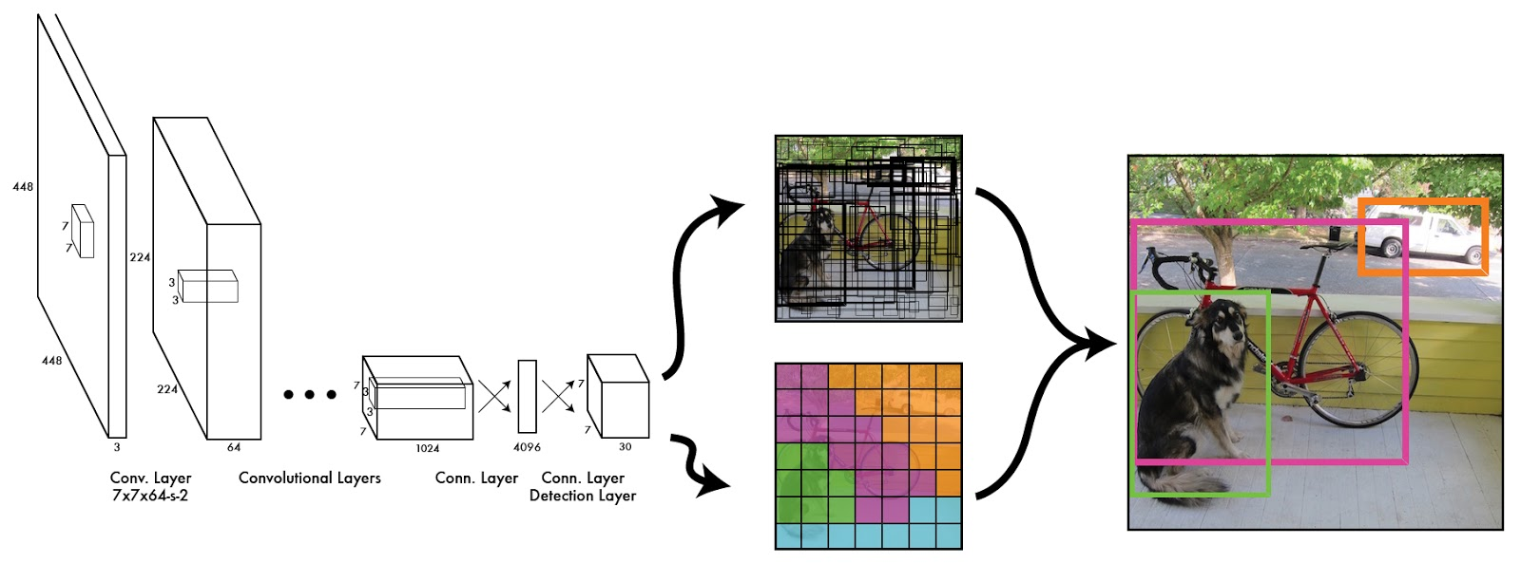
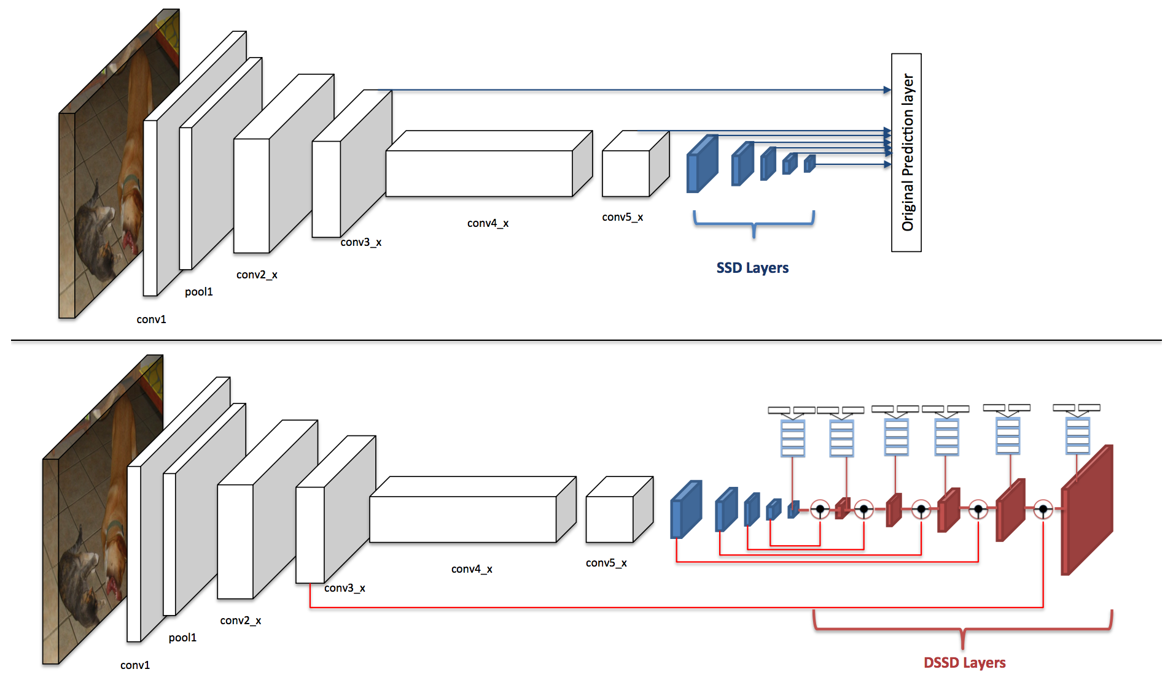
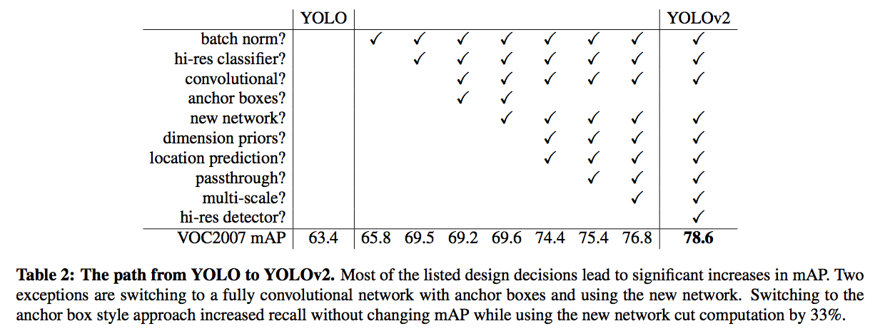
Object Detection Models
Single-stage models
YOLO (CVPR 2016)
SSD (ECCV 2016)
YOLOv2 (CVPR 2017)
DSSD (arXiv 2017)

Slide 12
Specific Domains of Object Detection
Face Detection
https://www.dailydot.com/debug/face-detection-algorithm-image-search/
Pedestrian Detection
https://www.cis.upenn.edu/~jshi/ped_html/
Notes:
Domain can be narrow down to specific object.
For example, we can detect only the face or pedestrian.

Slide 13
Specific Domains of Object Detection
Face Detection
Improving Occlusion and Hard Negative Handling for Single-Stage Pedestrian Detectors
https://www.dailydot.com/debug/face-detection-algorithm-image-search/
Pedestrian Detection
https://www.cis.upenn.edu/~jshi/ped_html/
Notes:
Domain can be narrow down to specific object.
For example, we can detect only the face or pedestrian.

Slide 14
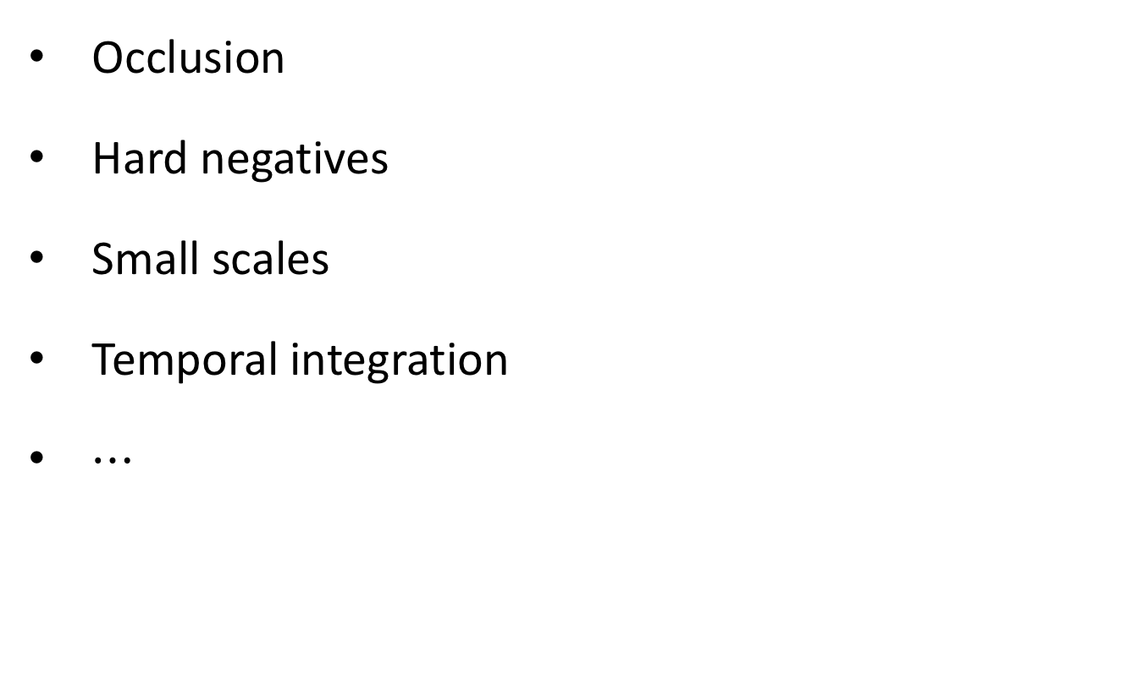
Issues of Pedestrian Detection
Occlusion
Hard negatives
Small scales
Temporal integration
$⋯$

Slide 15
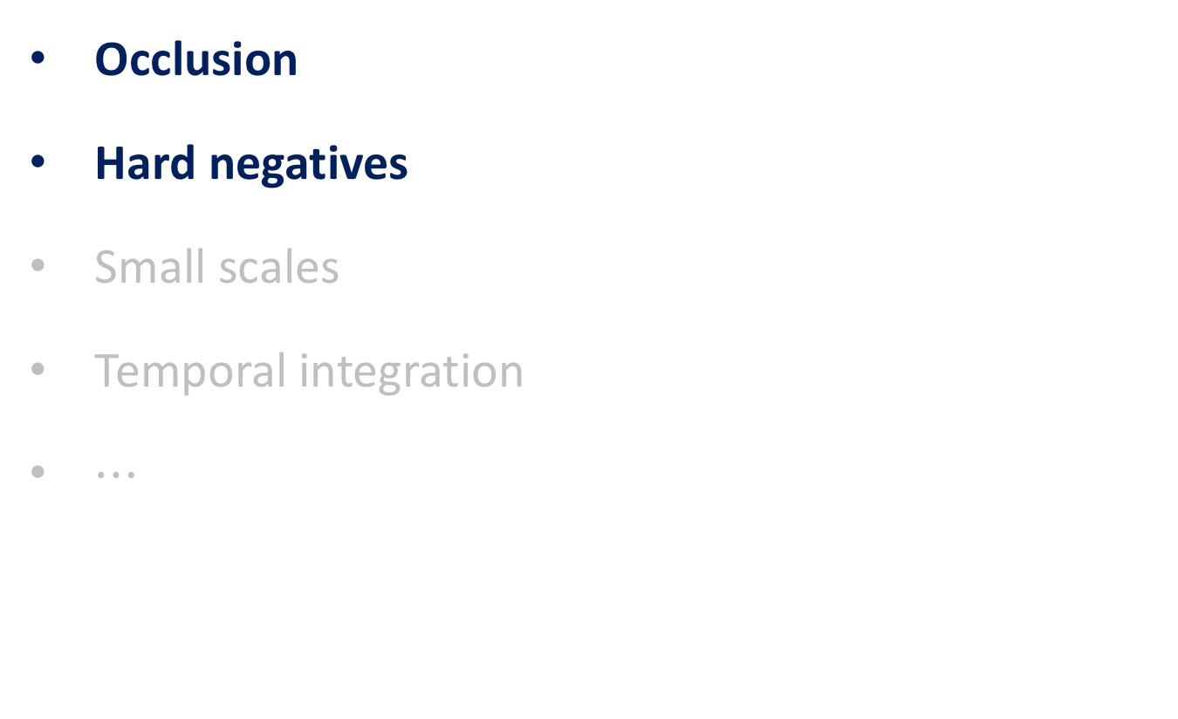
Issues of Pedestrian Detection
Occlusion
Hard negatives
Small scales
Temporal integration
$⋯$
Improving Occlusion and Hard Negative Handling for Single-Stage Pedestrian Detectors

Slide 16
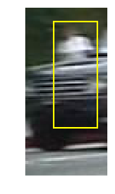
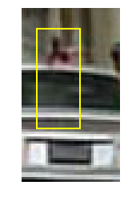
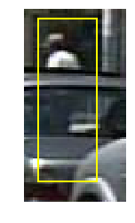
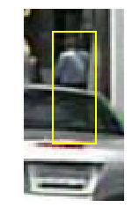
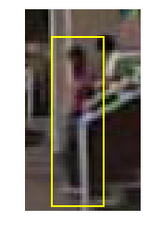
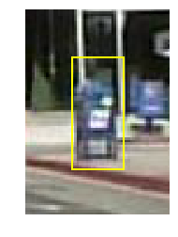
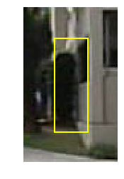
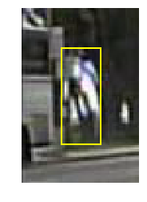
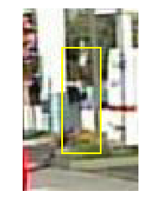
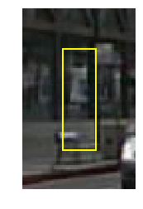
Issues of Pedestrian Detection
Occlusion as false negative failure
Hard negatives as false positive failure

Slide 17
Our Solutions

Slide 18
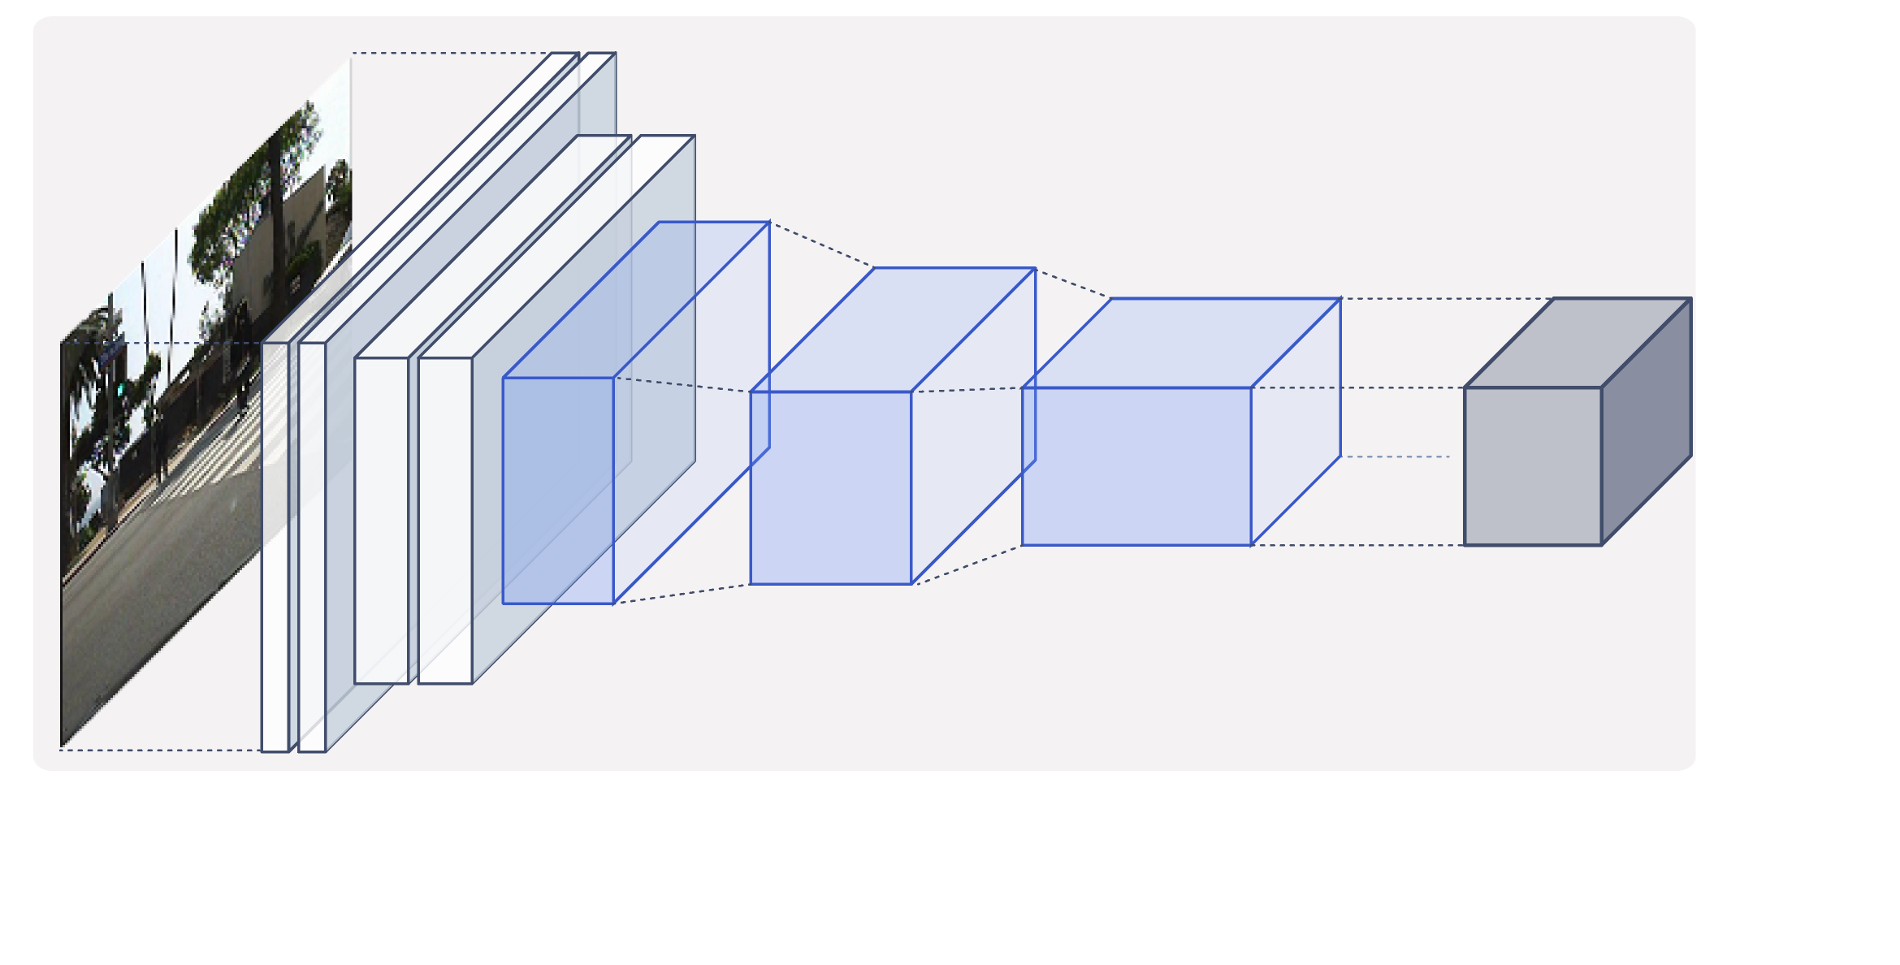
Our Solutions
Make additional tasks and corresponding modules to refine the results!
Base Network

Slide 19
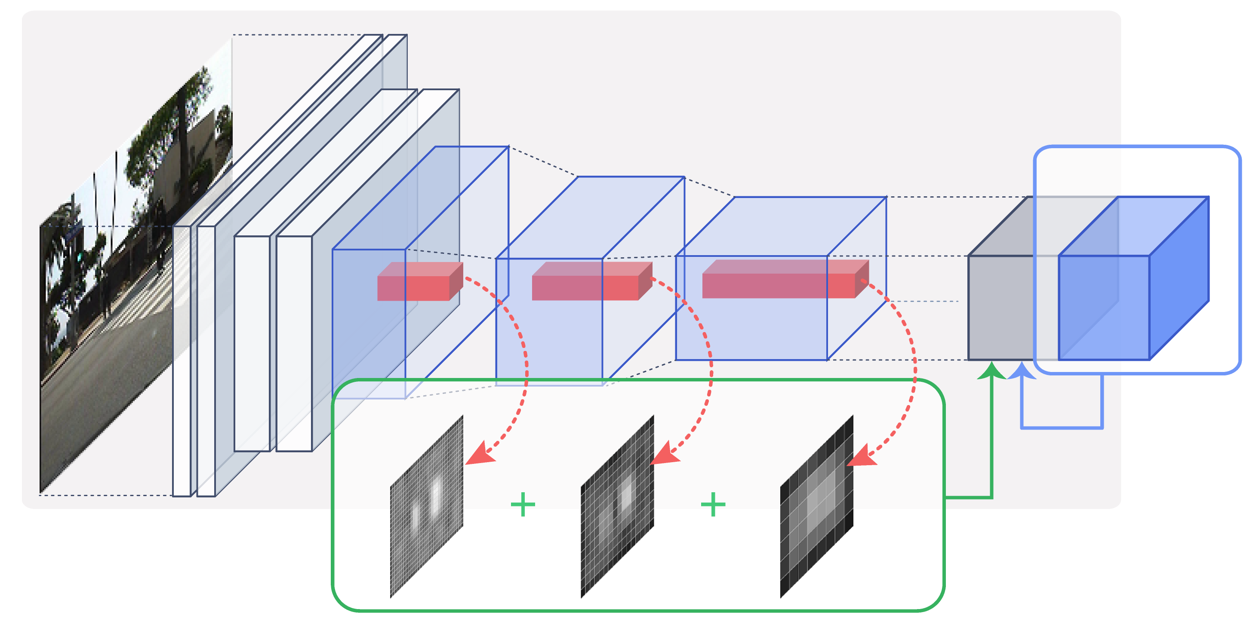
Our Solutions
Make additional tasks and corresponding modules to refine the results!
Base Network
Part Score
Grid Classifiers
Refinement

Slide 20
Our Solutions: Base Networks
Structure of output tensor
Output formats of four methods per anchor
Notes:
이 4개의 모형을 베이스라인으로 사용

Slide 21
Our Solutions: Base Networks

Slide 22
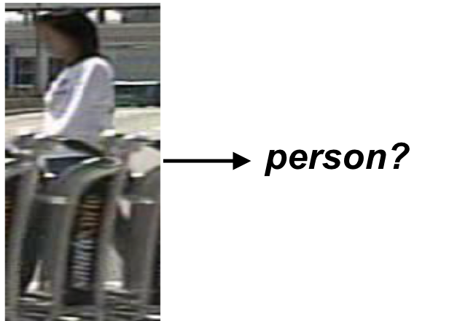
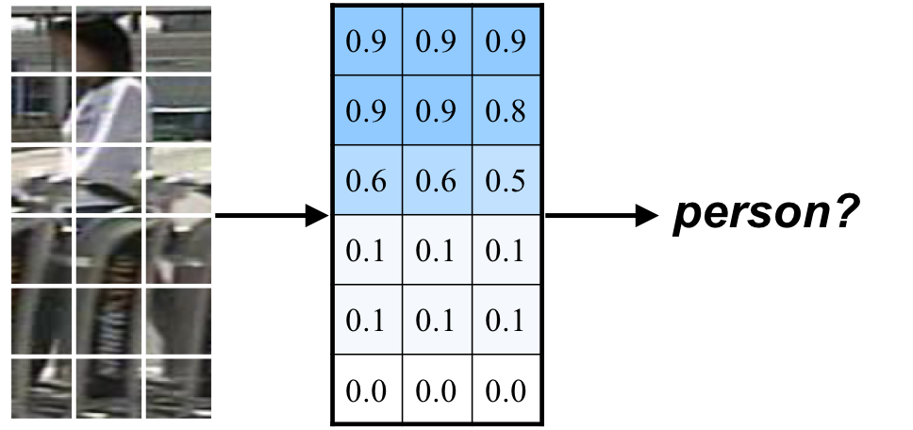
Our Solutions: Occlusion Handling
Problem
Likely to assign a low confidence to an occluded person
Solution
Divide the prediction confidence by parts, and use it for final prediction
Existing detection task
Our additional task
Notes:
Caltech, citypersons

Slide 23
Our Solutions: Occlusion Handling
Problem
Likely to assign a low confidence to an occluded person
Solution
Divide the prediction confidence by parts, and use it for final prediction
Existing detection task
Our additional task
Notes:
Caltech, citypersons

Slide 24
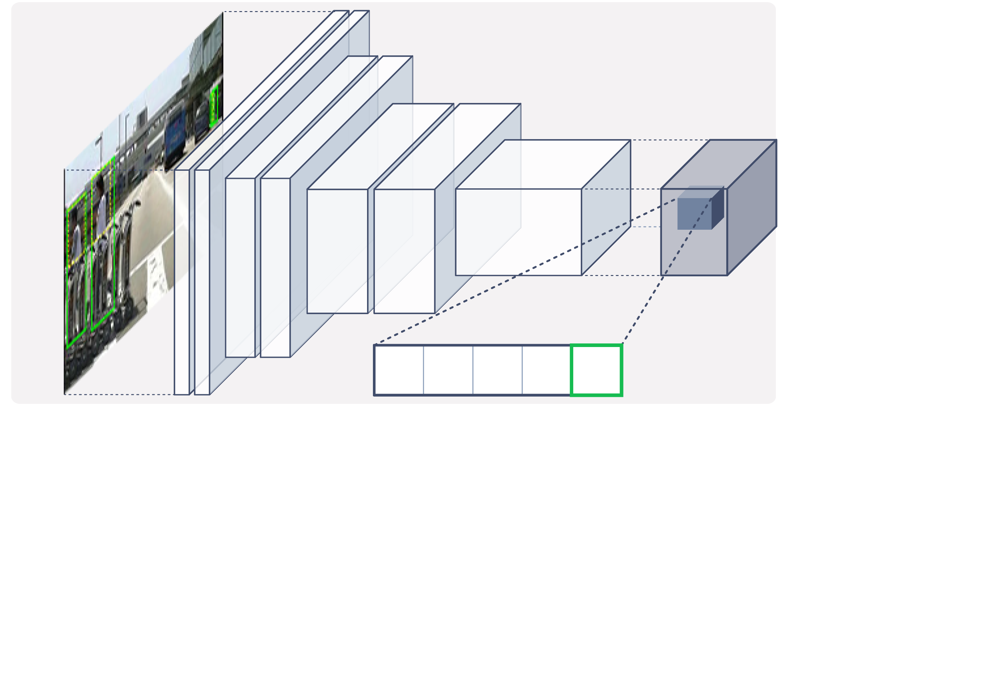
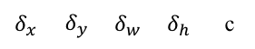
Our Solutions: Occlusion Handling
Detailed architecture
Base Network
Output tensor
Input Image
$$δ_{x}$$ | $$δ_{y}$$ | $$δ_{w}$$ | $$δ_{h}$$ | c
Notes:
Max / soft part score

Slide 25
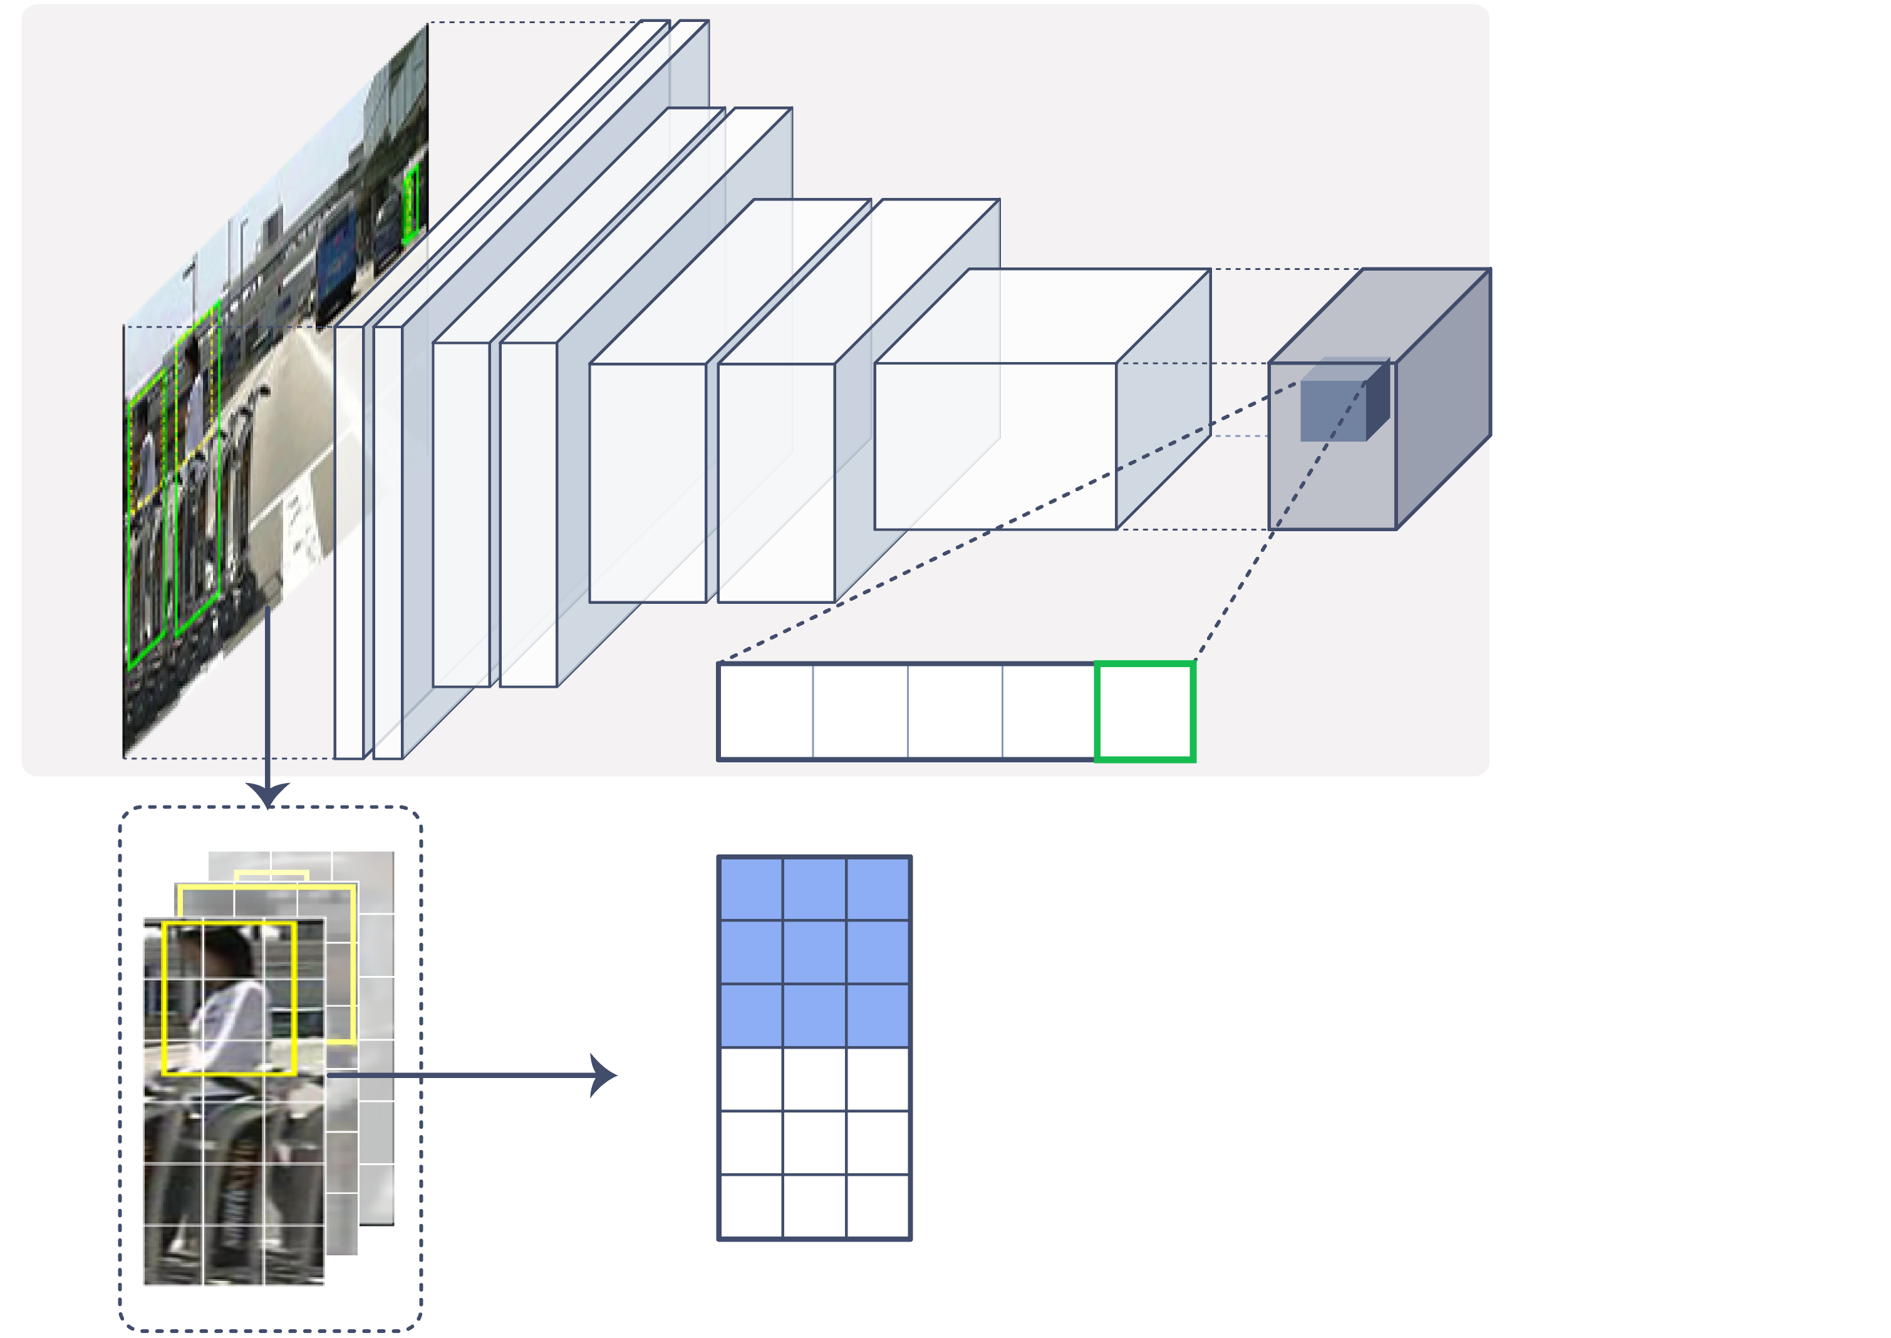
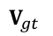
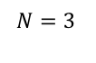

Our Solutions: Occlusion Handling
Detailed architecture
Base Network
Output tensor
Input Image
$$δ_{x}$$ | $$δ_{y}$$ | $$δ_{w}$$ | $$δ_{h}$$ | c
$$V_{gt}$$
1 | 1 | 1
1 | 1 | 1
1 | 1 | 1
0 | 0 | 0
0 | 0 | 0
0 | 0 | 0
Ground Truth (BBs)
$$M=6$$
$$N=3$$
Notes:
Max / soft part score

Slide 26
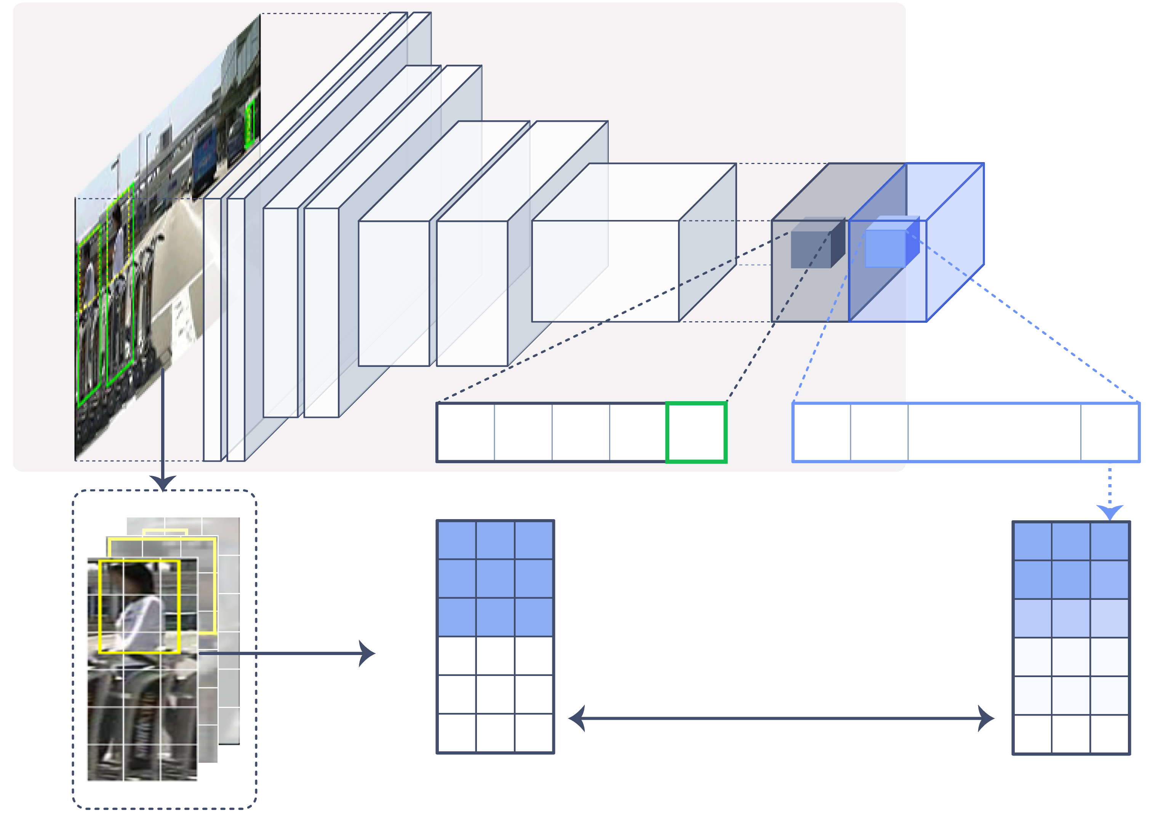
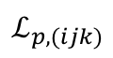
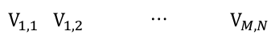

Our Solutions: Occlusion Handling
Detailed architecture
Base Network
Output tensor
Input Image
$$δ_{x}$$ | $$δ_{y}$$ | $$δ_{w}$$ | $$δ_{h}$$ | c
$$V_{1,1}$$ | $$V_{1,2}$$ | $$⋯$$ | $$V_{M,N}$$
$$V_{gt}$$
$$\hat{V}$$
1 | 1 | 1
1 | 1 | 1
1 | 1 | 1
0 | 0 | 0
0 | 0 | 0
0 | 0 | 0
0.9 | 0.9 | 0.9
0.9 | 0.9 | 0.8
0.6 | 0.6 | 0.5
0.1 | 0.1 | 0.1
0.1 | 0.1 | 0.1
0.0 | 0.0 | 0.0
Ground Truth (BBs)
$$M=6$$
$$ℒ_{p,(ijk)}$$
$$N=3$$
Notes:
Max / soft part score

Slide 27
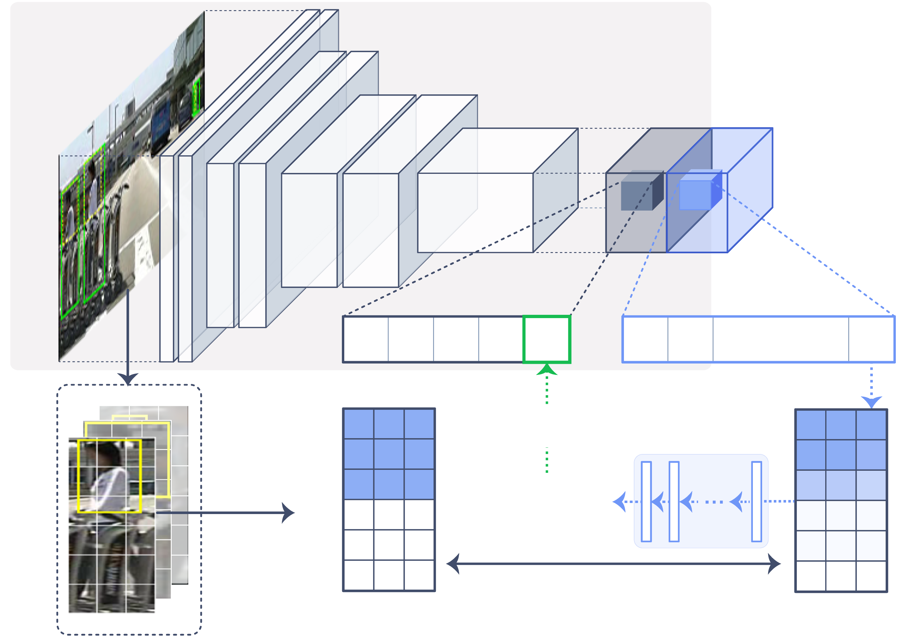

Our Solutions: Occlusion Handling
Detailed architecture
Base Network
Output tensor
Input Image
$$δ_{x}$$ | $$δ_{y}$$ | $$δ_{w}$$ | $$δ_{h}$$ | c
$$V_{1,1}$$ | $$V_{1,2}$$ | $$⋯$$ | $$V_{M,N}$$
$$V_{gt}$$
Part score generator
$$\hat{V}$$
1 | 1 | 1
1 | 1 | 1
1 | 1 | 1
0 | 0 | 0
0 | 0 | 0
0 | 0 | 0
Refinement
0.9 | 0.9 | 0.9
0.9 | 0.9 | 0.8
0.6 | 0.6 | 0.5
0.1 | 0.1 | 0.1
0.1 | 0.1 | 0.1
0.0 | 0.0 | 0.0
Ground Truth (BBs)
$$M=6$$
$$s_{person}$$
$$ℒ_{p,(ijk)}$$
$$N=3$$
Notes:
Max / soft part score

Slide 28
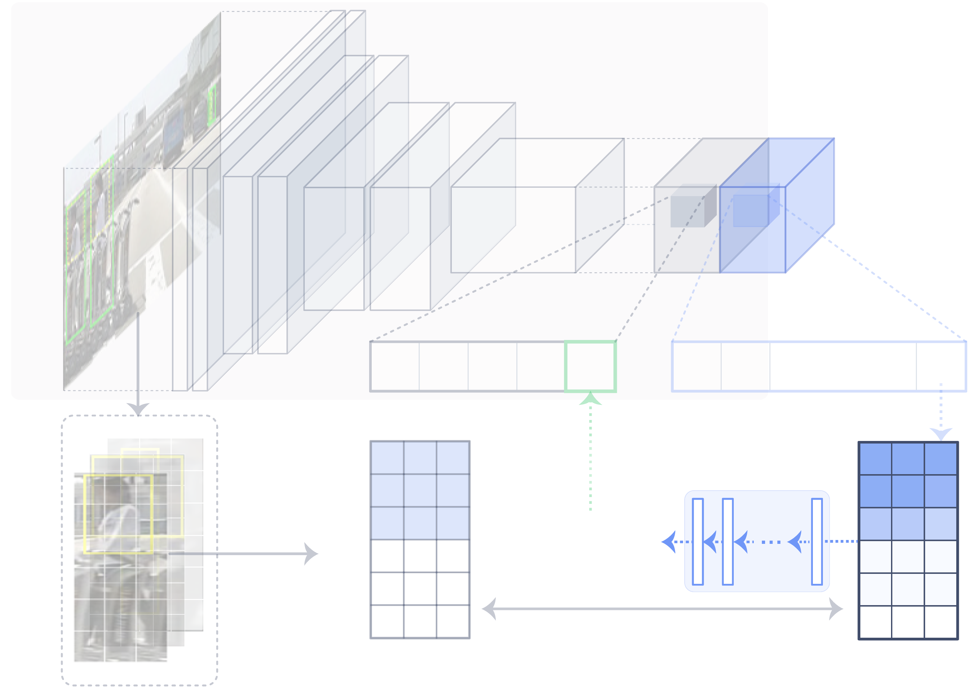


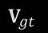


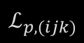
Our Solutions: Occlusion Handling
Two types of part score (generator)
Base Network
Output tensor
Input Image
$$δ_{x}$$ | $$δ_{y}$$ | $$δ_{w}$$ | $$δ_{h}$$ | c
$$V_{1,1}$$ | $$V_{1,2}$$ | $$⋯$$ | $$V_{M,N}$$
$$V_{gt}$$
Part score generator
$$\hat{V}$$
1 | 1 | 1
1 | 1 | 1
1 | 1 | 1
0 | 0 | 0
0 | 0 | 0
0 | 0 | 0
Refinement
0.9 | 0.9 | 0.9
0.9 | 0.9 | 0.8
0.6 | 0.6 | 0.5
0.1 | 0.1 | 0.1
0.1 | 0.1 | 0.1
0.0 | 0.0 | 0.0
Ground Truth (BBs)
$$M=6$$
$$s_{person}$$
$$ℒ_{p,(ijk)}$$
$$N=3$$
Notes:
Max / soft part score

Slide 29
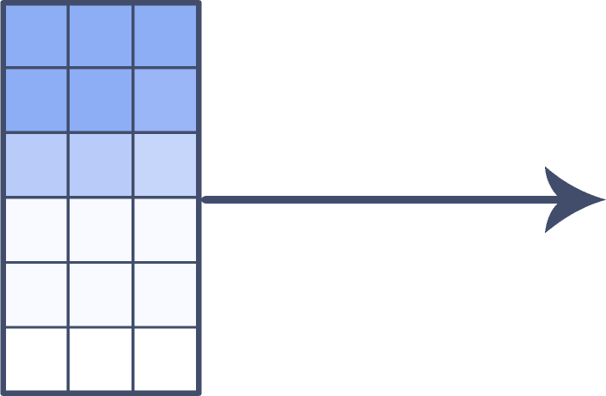
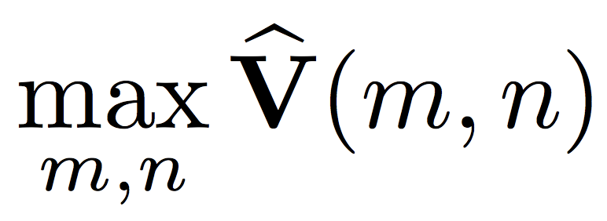
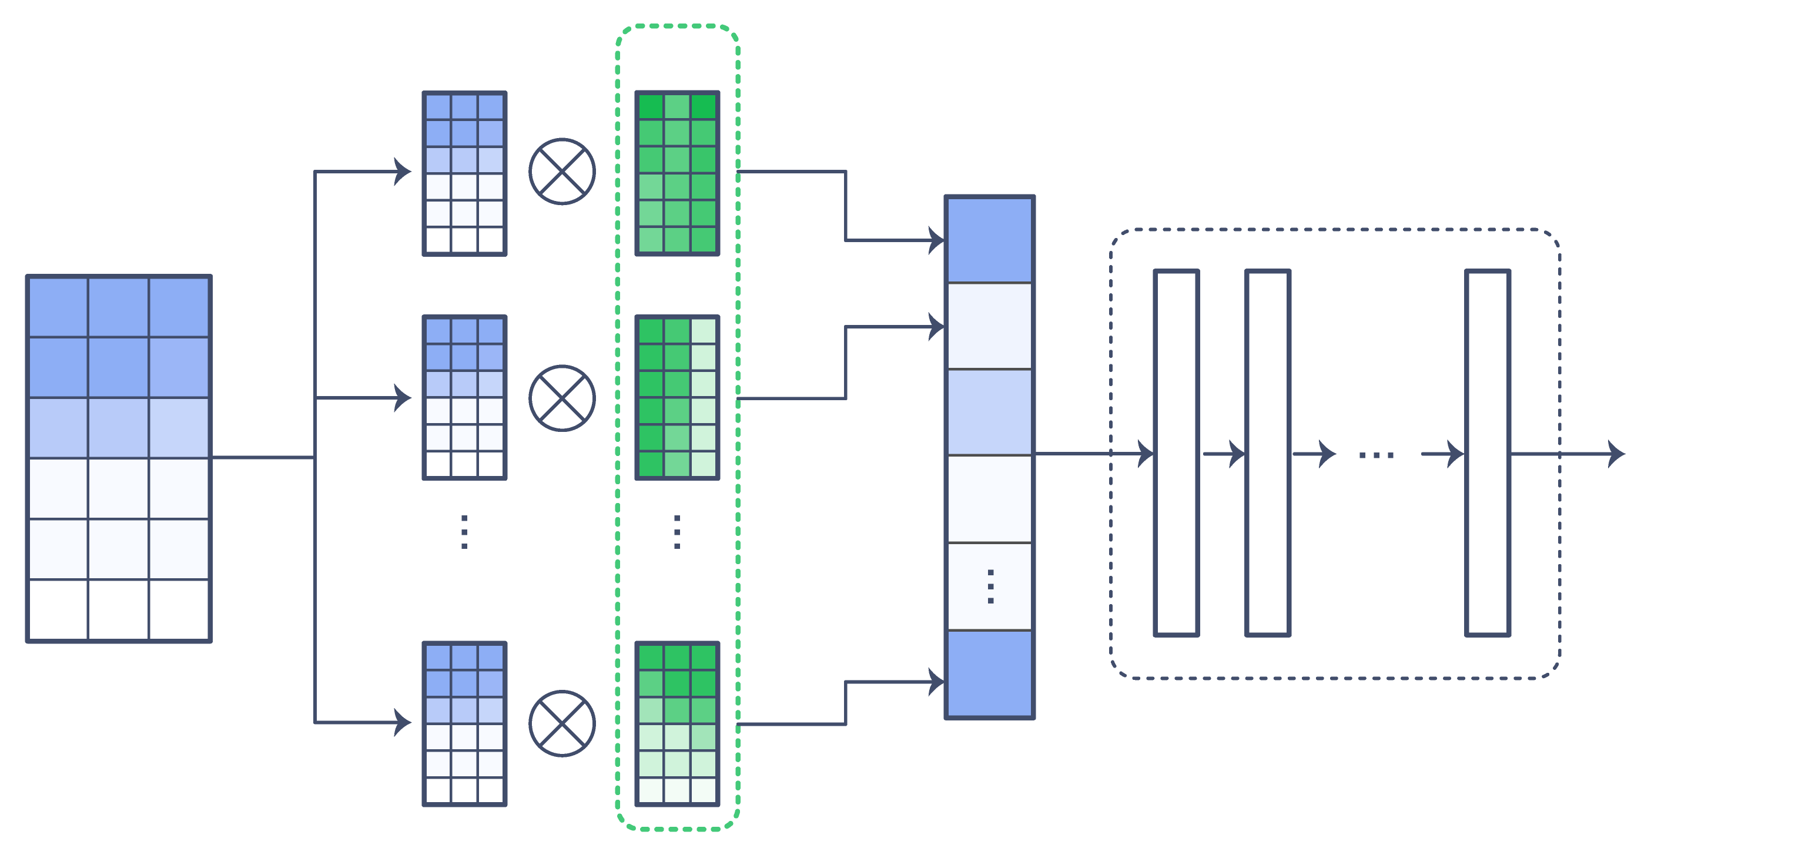
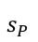
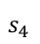
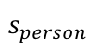
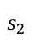
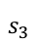








Our Solutions: Occlusion Handling
Two types of part score (generator)
Max part score
$$\hat{V}$$
0.9 | 0.9 | 0.9
0.9 | 0.9 | 0.8
0.6 | 0.6 | 0.5
0.1 | 0.1 | 0.1
0.1 | 0.1 | 0.1
0.0 | 0.0 | 0.0
$$s_{person}$$
Soft part score
$$\hat{V}$$
$$W_{1}$$
$$\hat{V}$$
$$s_{1}$$
0.9 | 0.9 | 0.9
0.9 | 0.9 | 0.8
0.6 | 0.6 | 0.5
0.1 | 0.1 | 0.1
0.1 | 0.1 | 0.1
0.0 | 0.0 | 0.0
$$\hat{V}$$
$$W_{2}$$
$$s_{2}$$
$$s_{3}$$
$$s_{person}$$
$$s_{4}$$
$$\hat{V}$$
$$W_{P}$$
$$s_{P}$$
Classifier
Soft parts
Notes:
안좋은 예시

Slide 30


Our Solutions: Occlusion Handling
Two types of part score (generator)
Max part score
$$\hat{V}$$
$$\hat{V}$$
0.9 | 0.9 | 0.9
0.9 | 0.9 | 0.8
0.6 | 0.6 | 0.5
0.1 | 0.1 | 0.1
0.1 | 0.1 | 0.1
0.0 | 0.0 | 0.0
0.9 | 0.0 | 0.0
0.9 | 0.0 | 0.0
0.6 | 0.0 | 0.0
0.1 | 0.1 | 0.5
0.1 | 0.1 | 0.9
0.0 | 0.0 | 0.9
$$s_{person}$$
c.f.
Soft part score
$$\hat{V}$$
$$W_{1}$$
$$\hat{V}$$
$$s_{1}$$
0.9 | 0.9 | 0.9
0.9 | 0.9 | 0.8
0.6 | 0.6 | 0.5
0.1 | 0.1 | 0.1
0.1 | 0.1 | 0.1
0.0 | 0.0 | 0.0
$$\hat{V}$$
$$W_{2}$$
$$s_{2}$$
$$s_{3}$$
$$s_{person}$$
$$s_{4}$$
$$\hat{V}$$
$$W_{P}$$
$$s_{P}$$
Classifier
Soft parts
Notes:
안좋은 예시

Slide 31
Our Solutions: Occlusion Handling
Two types of part score (generator)
Max part score
$$\hat{V}$$
$$\hat{V}$$
0.9 | 0.9 | 0.9
0.9 | 0.9 | 0.8
0.6 | 0.6 | 0.5
0.1 | 0.1 | 0.1
0.1 | 0.1 | 0.1
0.0 | 0.0 | 0.0
0.9 | 0.0 | 0.0
0.9 | 0.0 | 0.0
0.6 | 0.0 | 0.0
0.1 | 0.1 | 0.5
0.1 | 0.1 | 0.9
0.0 | 0.0 | 0.9
$$s_{person}$$
c.f.
Soft part score
$$\hat{V}$$
$$W_{1}$$
$$\hat{V}$$
$$s_{1}$$
0.9 | 0.9 | 0.9
0.9 | 0.9 | 0.8
0.6 | 0.6 | 0.5
0.1 | 0.1 | 0.1
0.1 | 0.1 | 0.1
0.0 | 0.0 | 0.0
$$\hat{V}$$
$$W_{2}$$
$$s_{2}$$
$$s_{3}$$
$$s_{person}$$
$$s_{4}$$
$$\hat{V}$$
$$W_{P}$$
$$s_{P}$$
Classifier
Soft parts
Notes:
Max / soft part score

Slide 32

Our Solutions: Hard Negative Handling
1st Problem
Mismatch of the predicted region with its feature region
R: ground truth (GT)
Notes:
hard negative 이슈에 대헤 어떻게 접근했는지
왜 혼동을 할까? 혼동을 덜 할 수 있도록 좀 더 확실한 값을 구해서 이를 이용하도록

Slide 33
Our Solutions: Hard Negative Handling
1st Problem
Mismatch of the predicted region with its feature region
R: ground truth (GT)
B: GT’s responsible anchor

Slide 34
Our Solutions: Hard Negative Handling
1st Problem
Mismatch of the predicted region with its feature region
R: ground truth (GT)
B: GT’s responsible anchor
G: anchor’s corresponding grid

Slide 35


Our Solutions: Hard Negative Handling
1st Problem
Mismatch of the predicted region with its feature region
Existing detection task:
(for each anchor $i$) Is there a person near here? ($p_{i}$) And where is it? ($δ_{i,x},δ_{i,y},δ_{i,w},δ_{i,h}$)
Notes:
엄밀히는 앵커별로

Slide 36


Our Solutions: Hard Negative Handling
1st Problem
Mismatch of the predicted region with its feature region
Solution
Make easier task to focus on its feature region
Our additional task:
Is there a person? ($p$)

Slide 37



Our Solutions: Hard Negative Handling
1st Problem
Mismatch of the predicted region with its feature region
Solution
Make easier task to focus on its feature region
Person?

Slide 38
Our Solutions: Hard Negative Handling
2nd Problem
Risky to rely on only one feature map to predict output
Solution
Use the results of multiple layers
Person?

Slide 39


Our Solutions: Hard Negative Handling
2nd Problem
Risky to rely on only one feature map to predict output
Solution
Use the results of multiple layers
$$⋯$$
Person?

Slide 40

Our Solutions: Hard Negative Handling
However, these problems are not the cases for all single-stage models.
e.g. SSD
Notes:
Two-stage 모델에서도 이런 문제는 없음

Slide 41




Our Solutions: Hard Negative Handling
Detailed architecture
Base Network
$$F_{1}$$
$$F_{l}$$
$$F_{L}$$
Output tensor
Input Image
Detection results

Slide 42




Our Solutions: Hard Negative Handling
Detailed architecture
Base Network
$$F_{1}$$
$$F_{l}$$
$$F_{L}$$
Output tensor
Input Image
Detection results
$$G_{1,gt}$$
$$G_{l,gt}$$
$$G_{L,gt}$$
Ground Truth
GT generation

Slide 43










Our Solutions: Hard Negative Handling
Detailed architecture
Base Network
$$F_{1}$$
$$F_{l}$$
$$F_{L}$$
Output tensor
$$g_{1}$$
$$g_{l}$$
$$g_{L}$$
Input Image
Grid classification
$$ℒ_{g,1}$$
$$ℒ_{g,l}$$
$$ℒ_{g,L}$$
$${\hat{G}}_{1}$$
$${\hat{G}}_{l}$$
$${\hat{G}}_{L}$$
Detection results
$$G_{1,gt}$$
$$G_{l,gt}$$
$$G_{L,gt}$$
Ground Truth
GT generation

Slide 44

Our Solutions: Hard Negative Handling
Detailed architecture
Base Network
$$F_{1}$$
$$F_{l}$$
$$F_{L}$$
Output tensor
$$g_{1}$$
$$g_{l}$$
$$g_{L}$$
Input Image
Grid classification
$$ℒ_{g,1}$$
$$ℒ_{g,l}$$
$$ℒ_{g,L}$$
$${\hat{G}}_{1}$$
$${\hat{G}}_{l}$$
$${\hat{G}}_{L}$$
Detection results
$$G_{1,gt}$$
$$G_{l,gt}$$
$$G_{L,gt}$$
Resizing
Σ
Ground Truth
GT generation
Pixel classification

Slide 45
Experiments

Slide 46

Experimental Setting
Two benchmark datasets
Caltech
~250,000 images
Person | people | person?
CityPersons
~5,000 images
Pedestrian | rider | sitting person | other person
Notes:
11 sets: 6 for train, 5 for test
3000 for train, 2000 for val

Slide 47

Experimental Setting
Pre-defined subsets
Occlusion
None ($=$ 0), Partial ($≤$ 35), Heavy ($≤$ 80)
Scale (height)
Near ($≥$ 80), Medium ($≥$ 30), Far ($<$ 30)
Reasonable: (height $≥$ 50) & (None | Partial)
All: (height $≥$ 20) & (None | Partial | Heavy)

Slide 48

Experimental Setting
Pre-defined subsets
Occlusion
None ($=$ 0), Partial ($≤$ 35), Heavy ($≤$ 80)
Scale (height)
Near ($≥$ 80), Medium ($≥$ 30), Far ($<$ 30)
Reasonable: (height $≥$ 50) & (None | Partial)
All: (height $≥$ 20) & (None | Partial | Heavy)
All50: (height ≥ 50) & (None | Partial | Heavy)

Slide 49

Experimental Setting
Evaluation metric: log-average miss rate
Average value of miss rates for 9 FPPI (false positives per image) rates evenly spaced in the log-space ranging from 10⁻² to 10⁰

Slide 50

Experimental Results
Occlusion handling (Caltech test)

Slide 51
Experimental Results
Occlusion handling (Caltech test)
Soft < Max < Base

Slide 52
Experimental Results
Occlusion handling (Caltech test)
Max part score can be better

Slide 53

Experimental Results
Hard negative handling (Caltech test)
Notes:
디텍션을 학습할 때 주는 정보가 굉장히 적다.

Slide 54
Experimental Results
Hard negative handling (Caltech test)
Doesn’t work well for SSD and DSSD
Notes:
디텍션을 학습할 때 주는 정보가 굉장히 적다.

Slide 55

Experimental Results
Overall (Caltech test)
* denotes that grid classifiers are used only for training.

Slide 56

Experimental Results
Overall (CityPersons val)
* denotes that grid classifiers are used only for training.

Slide 57


Experimental Results
Size (in MB)
Time (in miliseconds)

Slide 58
Experimental Results
Additional size and time overheads are very small
Size (in MB)
Time (in miliseconds)

Slide 59
Experimental Results
Occlusion handling: success cases

Slide 60
Experimental Results
Occlusion handling: failure cases

Slide 61
Experimental Results
Hard negative handling: negative examples

Slide 62
Experimental Results
Hard negative handling: positive examples

Slide 63
References
Pedestrian detection datasets
(Caltech) P. Dollar, et al. Pedestrian Detection: An Evaluation of the State of the Art. PAMI 2012.
(CityPersons) S. Zhang, et al. CityPersons: A Diverse Dataset for Pedestrian Detection. In CVPR 2017.
Two-stage models
(R-CNN) R. Girshick, et al. Rich Feature Hierarchies for Accurate Object Detection and Semantic Segmentation. In CVPR, 2014.
(Fast R-CNN) R. Girshick. Fast R-CNN. In ICCV, 2015.
(Faster R-CNN) S. Ren, K. He, R. Girshick, and J. Sun. Faster R-CNN: Towards Real-Time Object Detection with Region Proposal Networks. In NIPS, 2015.
(R-FCN) J. Dai,et al. R-FCN: Object Detection via Region-based Fully Convolutional Networks. In NIPS, 2016.
Single-stage models
(YOLO) J. Redmon, et al. You Only Look Once: Unified, Real-Time Object Detection. In CVPR, 2016.
(SSD) W. Liu, et al. SSD: Single Shot MultiBox Detector. In ECCV 2016.
(SqueezeDet+) B. Wu, et al. SqueezeDet: Unified, Small, Low Power Fully Convolutional Neural Networks for Real-Time Object Detection for Autonomous Driving. arXiv 2016.
(YOLOv2) J. Redmon and A. Farhadi. YOLO9000: Better, Faster, Stronger. In CVPR 2017.
(DSSD) C.-Y. Fu, et al. DSSD: Deconvolutional Single Shot Detector. arXiv 2017.

Slide 64
Q & A
Thank You!

